Slide 1
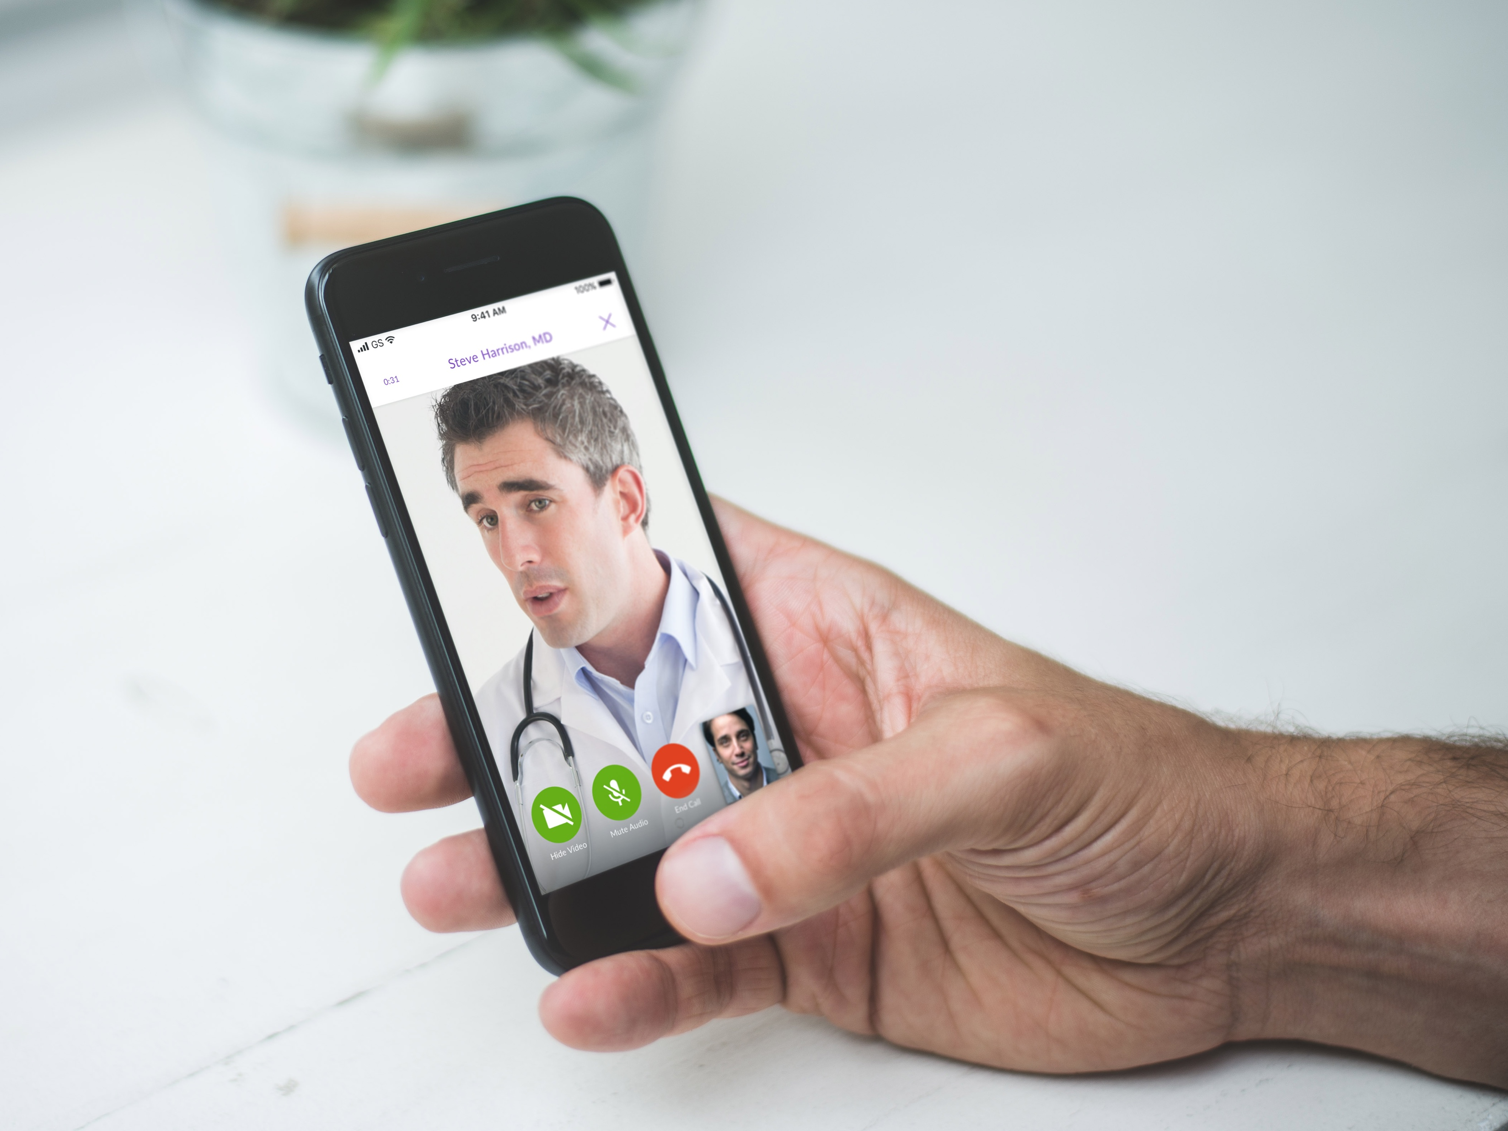



The First Stop for All Your Healthcare Needs
As Seen In

Slide 2
What is HealthJoy?

Slide 3

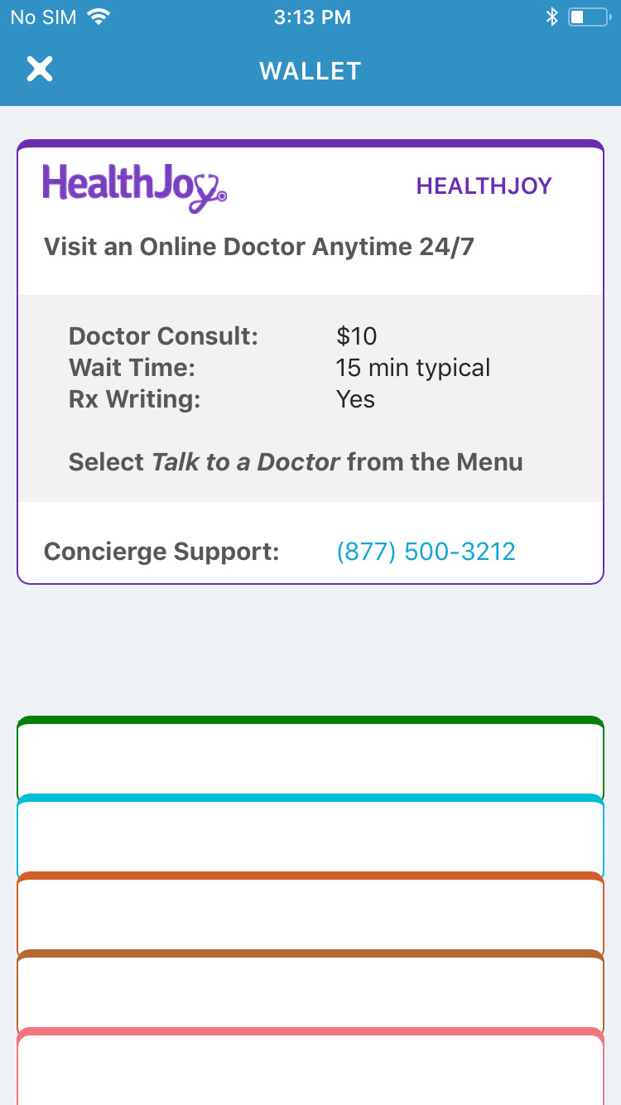

HEALTHJOY: ON-DEMAND BENEFITS GUIDANCE
Mission Control for Your Employee Benefits
Access and understand you benefits
On-demand LIVE help
Make smart choices
Save time and money
Chat or phone
24/7/365
MEDICAL
DENTAL
HSA
LIFE INSURANCE
WELLNESS

Slide 4
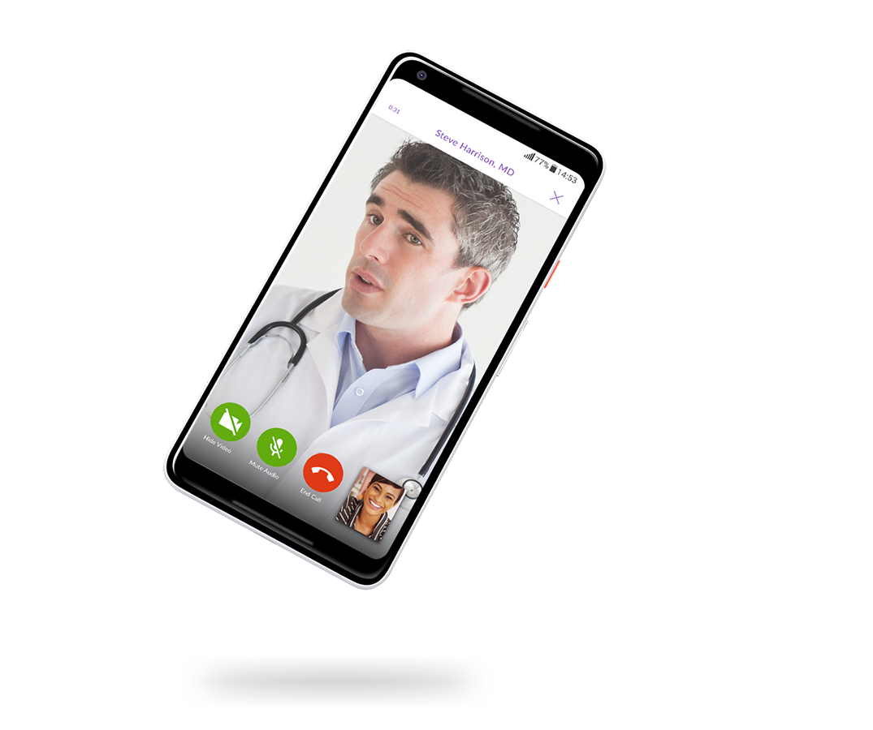
HEALTHJOY: Online Medical Consultations
            1,250 Credentialed Providers
            Average Wait Time - 8 Minutes
            94% of patients are successfully treated
            Prescriptions, including short term refills, are sent to local pharmacies that you choose
            NCQA accredited in credentialing, in accordance with the strictest quality standards.

Slide 5
HEALTHJOY: Online Medical Consultations
What We Treat
Allergies
Asthma
Bites & Stings
Body Aches
Bronchitis
Cough
Fever
Prescription Refills
Pink Eye
STIs
Sinus Infections
Sprains & Strains
UTIs
And more…
Don’t wait in an emergency room or urgent care center for diagnosis and treatment.

Slide 6

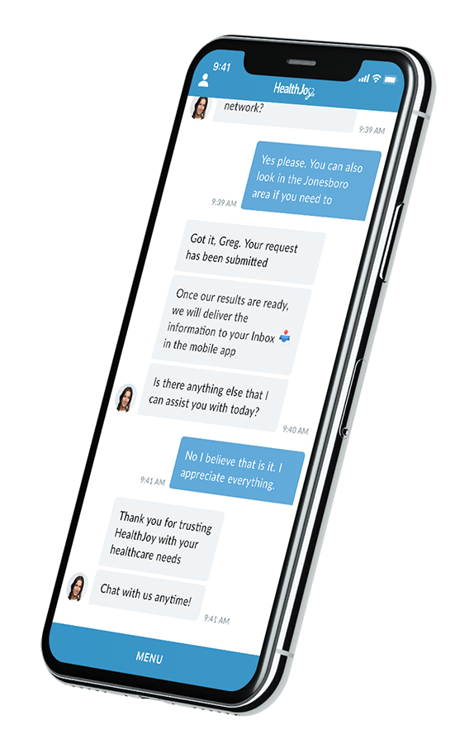
HEALTHJOY: Healthcare Concierge
Provider Recommendations
Facility Recommendations
Answer Benefits Questions
Appointment Booking
Health Cost Estimation
Health Spending Accounts
Dental and Vision Assistance

Slide 7

HEALTHJOY: Rx Savings Review
Our doctors have developed a proprietary algorithm to identify lower-cost medication alternatives by using 9 different strategies.
Therapeutic alternatives
Manufacturer coupons
Prescription assistance programs
Rx discount program
Mail-order
International Mail-Order
Pharmacy optimization
Dosage optimization
Generic alternatives

Slide 8
HEALTHJOY: Virtual Assistant
JOY is always instantly available to help you along the way
Welcomes you into the app
Will collect basic information and walk you through some processes
Sends you reminders to stay healthy and talk about important events
She is getting smarter every day and will provide new services all the time

Slide 9
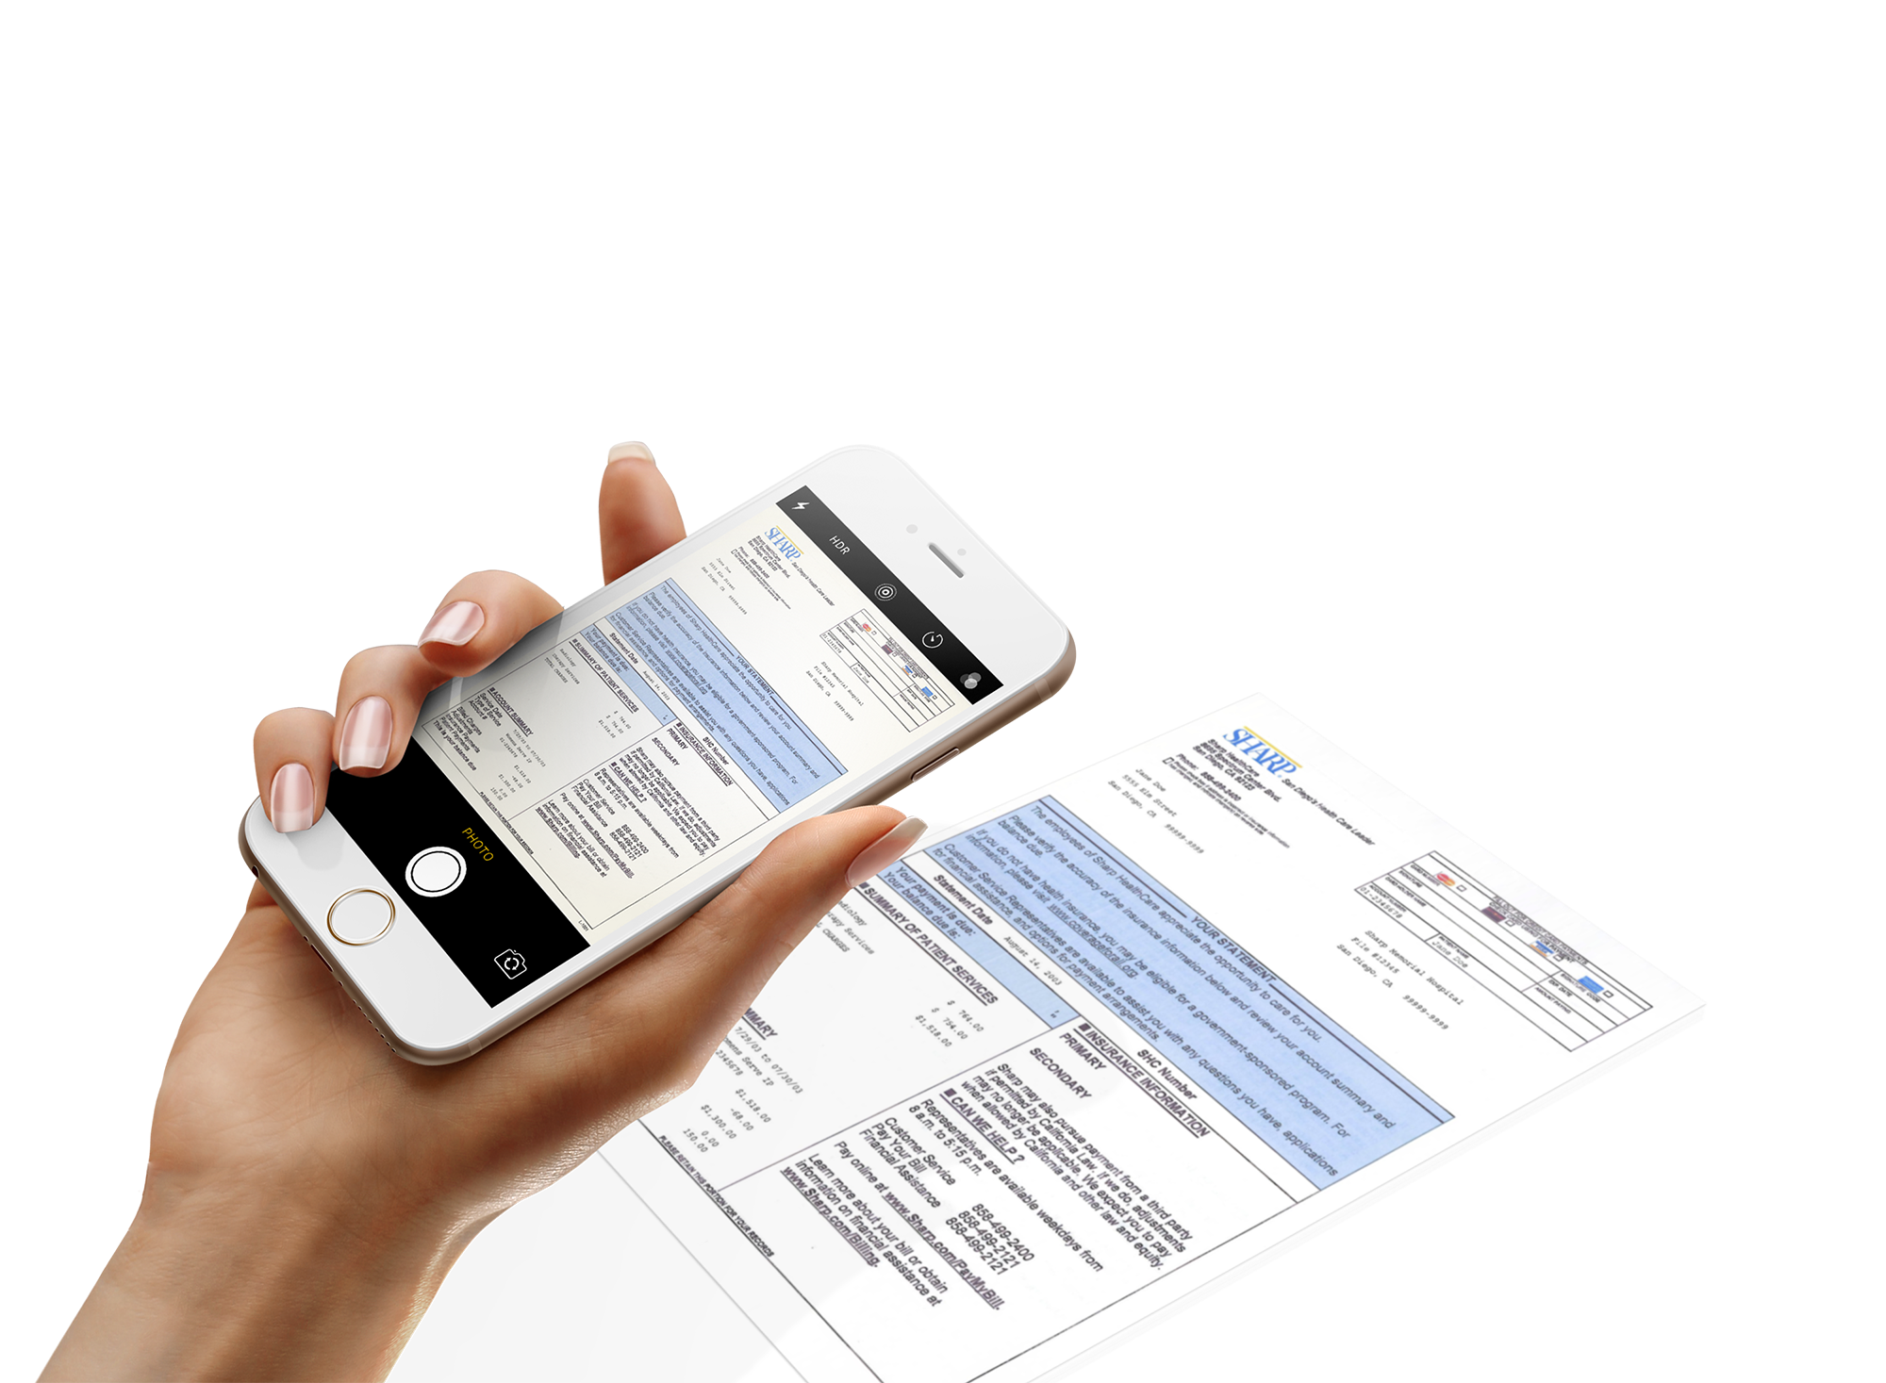
HEALTHJOY: Medical Bill Review
Get peace of mind with medical bills
Have a medical billing expert review bills
with the snap of a photo. We’ll even advocate
on your behalf and get those bills reduced

Slide 10
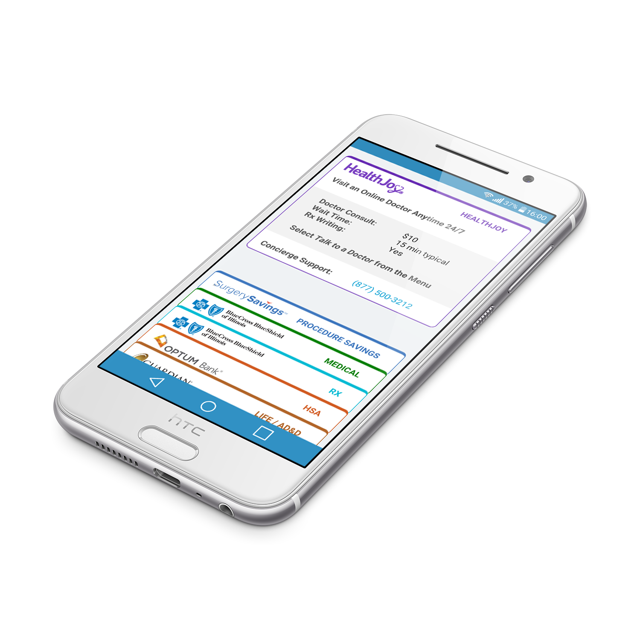
HEALTHJOY: Benefits Wallet
Contains all your benefits up to date benefits information
Medical Insurance
Dental
Vision
HSA
Prescription
Life, disability, and more

Slide 11
Why Use HealthJoy?

Slide 12
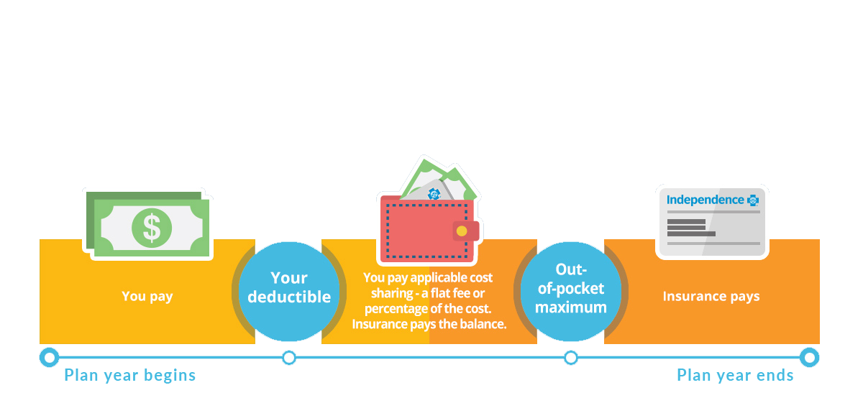
YOUR FINANCIAL EXPOSURE

Slide 13

BENEFITS ARE TOO CONFUSING
Medical
Dental
Vision
Wellness
Prescription
LTD/STD
FSA
Accident
Life & Disability
Critical Illness
Voluntary Life
Legal Protection
Voluntary Disability

Slide 14
DON’T MAKE UNINFORMED DECISIONS
Opportunity | Examples
Preventative Care | -unused, free preventative primary care -unused, free preventative dental care -unused, free preventative vision care
Point of Care | -unnecessary ER/urgent care -low quality physician care -high cost facility care
Prescriptions | -expensive prescriptions -expensive pharmacies
Medical Bills | -unrecognized billing errors -inexperience handling a billing error
Benefit Awareness | -unused, free EAP behavioral health care -unused Hospital Indemnity plan following inpatient care

Slide 15
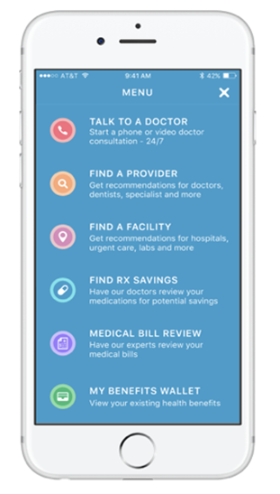
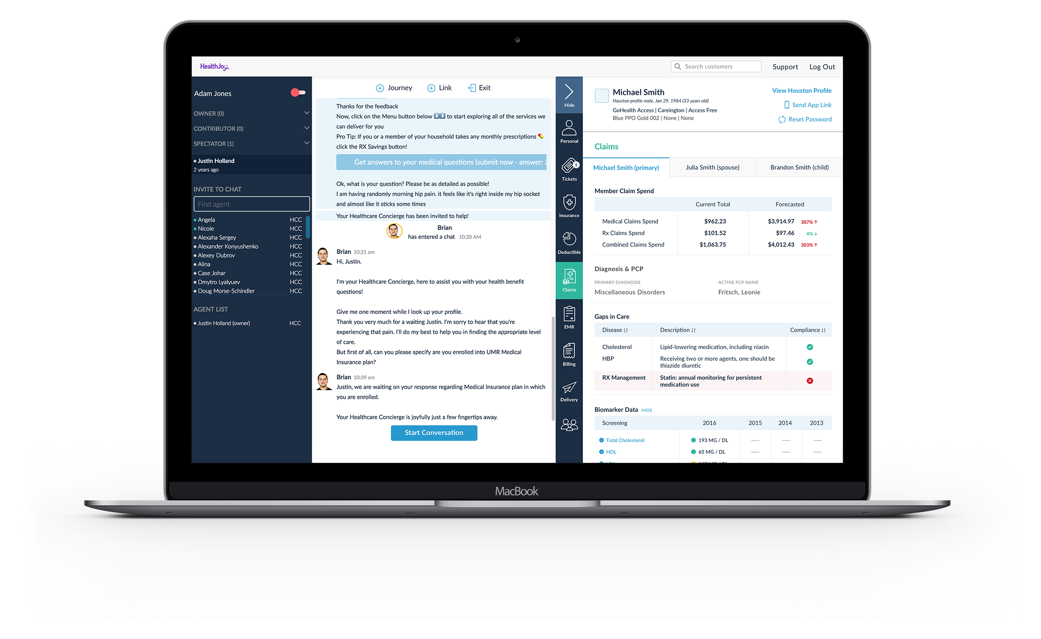
LET HEALTHJOY MAKE BENEFITS EASY
Data Framework
Benefit Plan Designs
Eligibility
Networks
Prescription Formulary
Cost/Quality
App
Member Engagement Platform

Slide 16


A BENEFIT YOU WILL LOVE!
4.8
out of 5
Amazing app
So useful
Why would you not use this?
Easy to use, keeps all health plan information in one place, and really helps you become a better consumer of healthcare.
This app is well designed and so easy to use. If you have the doctor consult option, it’s such a time and money saver. I also like how it’s setup mainly as a chat. Highly recommend for companies to use! As an employee, I dig it.
The convenience of a health concern at your fingertips and at your convenience! For those common issues this is the best way to get your concerns addressed. Efficient and so professional all through the visit! The app avatar is so Intuitive!
Jun 15
jt66224
May 5
Meg Mara
Jun 9
HurleySD

Slide 17
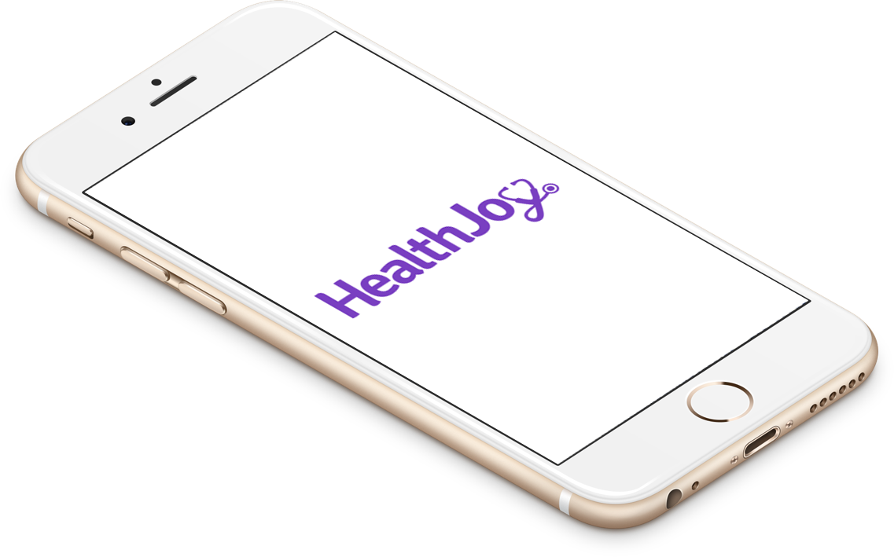

HEALTHJOY SIMPLIFIES HEALTHCARE
One app for your family’s healthcare needs
Consult with an online doctor
Live healthcare concierges
Researched provider & facility recommendations
Find lower-cost medication
Check bills for errors
Schedule appointments
Notes:
18-22% of claims are coming from RX! This is national averages and only goin up. This is a HUGE savings piece and we know it. Imagine being able to waive OOP expenses by proactively getting people on Mail Order that is then shipped to their home address? Convenient (member does nothing or have to go anywhere). Meds are shipped and delivered to their front door; OOP reduced because its cheaper and signifcant savings on employer side by Mail Order....people dont do mail order becasue its sucks to fill out paperwork; its a tedious task; etc)

